Slide 2
Horizon Europe structure
Pillar I
EXCELLENT SCIENCE
European Research Council
Mare Skłodowska-Curie
Research Infrastructures
Pillar II
GLOBAL CHALLENGES & EUROPEAN INDUSTRIAL COMPETITIVENESS
Health
Culture, Creativity & Inclusive Society
Civil Security for Society
Digital, Industry & Space
Climate, Energy & Mobility
Food, Bioeconomy, Natural Resources, Agriculture & Environment
Joint Research Centre
Pillar III
INNOVATIVE EUROPE
European Innovation Council
European Innovation Ecosystems
European Institute of Innovation & Technology
6 Clusters
WIDENING PARTICIPATION AND STRENGTHENING THE EUROPEAN RESEARCH AREA
Widening participation & spreading excellence
Reforming & Enhancing the European R&I system

Slide 3
European Innovation Council
Support to innovations with breakthrough and disruptive nature and scale up potential that are too risky for private investors (70% of the budget earmarked for SMEs)
Helping researchers and innovators create markets of the future, leverage private finance, scale up their companies
Innovation centric, risk taking & agile, pro-active management and follow up
Mostly ’bottom up’, but also targeting strategic challenges
EIC Programme Managers to develop visions for breakthroughs and steer portfolios
European
Innovation Council –
a one-stop-shop
Complementary instruments bridging the gap from idea to market
PATHFINDER
R&I grants
(from early technology to proof of concept)
TRANSITION
R&I grants
(proof of concept to pre-commercial)
ACCELERATOR Grants & investment (via EIC Fund) for single SMEs & start-ups
(from pre-commercial to market & scale-up)

Slide 4
EIC Pathfinder
funds research to develop the scientific basis to underpin
breakthrough technologies
Expected outcome: Proof of Principle/proof of concept

Slide 5
EIC Pathfinder Open
early stage development (TRL 1 – 4)
radically new technology, with potential to create new markets and/or to address global challenges
No incremental research
Interdisciplinary consortium
Outcome: Proof of Principle

Slide 6
EIC Pathfinder Open 2023
Collaborative research: at least 3 independent legal entities (3 out of 3)
EU contribution: up to 3 M€
Funding rate: 100 % (RIA)
Up to 17 pages of the proposal (Part B) 🡪 Excellence, Impact and Implementation
Q1 2023

Slide 7
EIC Pathfinder Challenges
Subject related (top-down) calls
TRL 2 – 4
Building on new, cutting-edge directions in science and technology to disrupt a field and a market or create new opportunities
Portfolio of projects that explore different perspectives, competing approaches or complementary aspects of the Challenge.

Slide 8
EIC Pathfinder Challenges 2023
3 out of 3, single applicants or small consortia (two partners)
Funding up to 4 M€
Funding rate: 100% (RIA)
Up to 25 pages of the proposal (Part B) 🡪 Excellence, Impact and Implementation
Q3 2023

Slide 9
EIC Transition
innovation activities that go beyond the experimental proof of principle in laboratory
TRL: (3)/4 bis 5/6
Expected outcome:
maturation and validation from the lab to the relevant application environments
Development of a business plan
EIC Transition Open
EIC Transition Challenges
Notes:
maturation and validation of your novel technology from the lab to the relevant application environments (by making use of prototyping, formulation, models, user testing or other validation tests)
explorations and development of a sustainable business case and business model towards commercialisation.

Slide 10
EIC Accelerator: Who can participate?
The EIC Accelerator provides support to start-ups and SMEs with
breakthrough, high-risk innovations (TRL 5/6)
large international market potential
European and global ambitions.
🡪 Develop innovations to market maturity
🡪 Start commercialisation
🡪 Blended Finance: grants + investment component

Slide 11
Was wird finanziert?
What kind of support do you get?
Zuwendung (Grant) bis 2,5 Mio. Euro (70% Förderquote)
Innovationsaktivitäten: Entwicklung, Demonstration und Prototyping, Zulassung, IP, vorbereitende Markteinführung
Grant up to 2.5 million euros (70% funding rate)
Innovation activities: development, demonstration and prototyping, approval, IP, preparatory market launch
Investment von 0,5 – 15 Mio. Euro
Finanzierung der Markteinführung und Scale-up
Investment of 0.5 - 15 million euros
Financing of the market launch and scale-up

Slide 12
When can you submit?
Step 3
Anytime:
accelerator.eismea.eu
Pitches app. 2 months after submission of full proposal
Step 2
Step 1
Next dates by invitation in 2023: 22nd of March, 7th of June, and 4th of October
Notes:
22nd of March, 7th of June and 4th of Oktober

Slide 13
How can you participate?
Full application
incl. coaching
Short application
Pitch deck
Pitch video
Step 3
Step 2
Pitch
interview
Step 1

Slide 14
What will be supported?
Was wird finanziert?
Zuwendung (Grant) bis 2,5 Mio. Euro (70% Förderquote)
Innovationsaktivitäten: Entwicklung, Demonstration und Prototyping, Zulassung, IP, vorbereitende Markteinführung
Investment von 0,5 – 15 Mio. Euro
Finanzierung der Markteinführung und Scale-up
Grant up to 2.5 Mio. Euro (70% financing)
Innovation activities: development, demonstration and prototyping, approval, IP,
Investment of 0.5 – 15 Mio. Euro
Financing of Market Launch & Scale-up

Slide 15
Parts of the short Proposal - Step 1
Online-Form („AI-Tool“)
Pitch Deck
Pitch Video
Step 1

Slide 16
Parts of the short Proposal - Step 1
Online- Form („AI-Tool“)
Pitch Deck
Pitch Video
Step 1

Slide 17
Online-Form („AI-Tool“)
Link to platform: accelerator.eismea.eu
Set up “EU-Login”
Apply for Participant Identification Code (PIC):
Modules on the platform for the Step 1 Proposal:
Diagnostic
Proposal

Slide 18
Online-Form („AI-Tool“)
Diagnostic
Diagnostic
Diagnostic Results
„Start submission“
nks-eic-acceleator.de

Slide 19
Online-Form („AI-Tool“)
Proposal
General Info
Project
Submission Form
Ideation
Development
Go2Market
Notes:
Fragen in Projekt teilweise dieselben wie in Diagnostic. Antworten werden übernommen

Slide 20
Project
Ideation
Development
Go2Market
What type(s) of solution(s) do you have in mind?
What kind of innovation?
What level is your innovation?
Describe your solution
Which solutions already exist and what are their limits?

Slide 21
Project
Ideation
Development
Go2Market
Describe your team (team complete?)
Do you plan to collaborate with other stakeholders?
Use Cases / Features
What are the risks of failure?
Why can't you carry out the project without the EIC?
Why are other sources of funding out of the question?
How much financing do you need (type of financing)?

Slide 22
Project
Ideation
Development
Go2Market I
Who will use the innovation?
What is your target market?
The target market is: new, emerging or mature
How will you market the innovation?
Who is interested in your innovation?
Can you estimate the time (years) until market launch?

Slide 23
Project
Ideation
Development
Go2Market II
Can you describe potential societal or industrial applications?
Will your innovation have an impact on society, the economy, the environment or the climate more broadly?
What are the benefits for your company in case of success?
Where do you see your company in 5 years?

Slide 24
Online-Form („AI-Tool“)
Proposal
General Info
Project
Submission Form
Ideation
Development
Go2Market
Notes:
Fragen in Projekt teilweise dieselben wie in Diagnostic. Antworten werden übernommen

Slide 25
Online-Form („AI-Tool“)
Proposal
Submission Form
General Info
Pitch Deck
Project
Pitch Video
Overview
Notes:
Fragen in Projekt teilweise dieselben wie in Diagnostic. Antworten werden übernommen

Slide 26
Parts of the short Proposal
Online-Form („AI-Tool“)
Pitch Deck
Pitch Video
Step 1

Slide 27
The Pitch Deck
Overview of your idea and highlights at a glance
Supplements the proposal and the video
No outline requirements
Observe the assessment criteria for the short application
"Reading deck", not intended for live presentation
More text than in the interview deck (full application)
Maximum 10 slides

Slide 28
The Pitch Deck – Suggestion on Outline
title slide
overview
problem
solution
team
target market
Competitors on the Market
Business Model / Financial Prognosis
Roadmap: steps to implementation and milestones
Funding requirements and closing statement
Notes:
Title slide - Pictures! Put yourself in the limelight. Company name and logo, slogan, mission statement. Company Snapshot - Traction, who are we and where are we now, TRL level, budget need. Mini elevator pitch. Customer problem or Opportunity - Who is the customer and what problem(s) do we solve? value proposition. Solution – product/service - What do we do and how? Innovation? Advantages over existing solutions? What risks? Team - Competence & track record Target Market - Market Size/Growth, Customer Segmentation, Home Market (Beachhead) Competition - Who are the competitors and why/how are we better? Business Model / Financial forecast - How will we make money and how fast? Income streams, value chain 3-5 years Roadmap: implementation & milestones - commercialization + product development, required financing Your ASK & why invest in us now - type & amount of investment & use of funds → Schedule a pitch deck webinar. However, there is no date yet

Slide 29
Parts of the short Proposal
Online Formular („AI-Tool“)
Pitch Deck
Pitch Video
Step 1

Slide 30
The Pitch Video
3 minutes
Featuring the three most important members of your team
Presentation of the innovation and the main motivation for your application
You should keep the video simple
The aim is to get to know the team behind the idea and their motivation
If the core team is not yet complete: present the plan
Language: English
Notes:
Wenn mehr Personen im Video vorkommen, sind die Gutachter angehalten auf das Kernteam zu fokussieren
Inhalt ist maßgeblich und nicht die Qualität und Sprache

Slide 31
The Pitch Video - Approach
Create a rough outline and schedule
Don't write down the exact wording. Use bullet points and practice!
Tip: Film the team members in an interview (Q&A) format. All answers must stand alone and be in complete sentences. Cut out / don't record the questions
Demonstrate product / demonstrator
Wear your everyday office attire
🡪 The aim is to have an appearance that is as authentic as possible!
Notes:
Be passionate! Speak in short, simple sentences Avoid technical jargon - use colloquial language Try using the Q&A style: Face the interviewer when answering, NOT the camera. Use gestures to appear more alive - video reduces the impact, you must feel like you're exaggerating Try standing up to have more energy instead of sitting down. Don't write a script - video yourself to practice! Consider a team video instead of taking individual shots.

Slide 32
The Pitch Video - Tools
A good smartphone is enough
But: use an external microphone
Stabilize with a tripod or gimbal
Pay attention to good lighting (ring light)
Film in landscape mode

Slide 33
Online-Form („AI-Tool“)
Proposal
Submission Form
General Info
Pitch Deck
Project
Pitch Video
Überblick
nks-eic-accelerator.de
Notes:
Fragen in Projekt teilweise dieselben wie in Diagnostic. Antworten werden übernommen

Slide 34
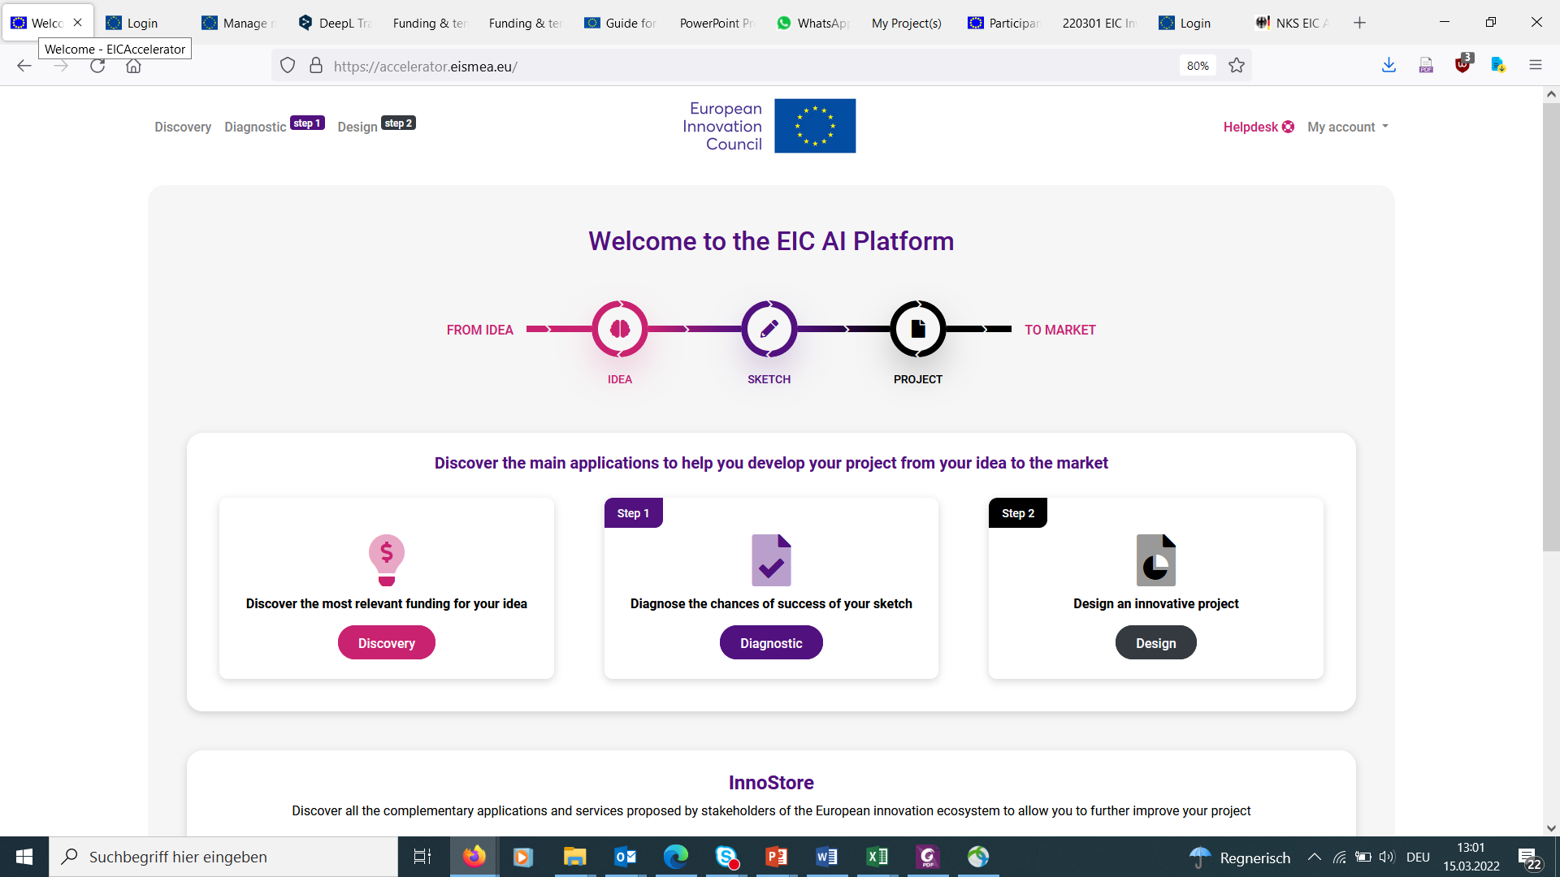

Slide 35
Evaluation
Evaluator 1
2 or more„GOs“
invitation for
full application
Evaluator 2
Evaluator 3
0-1 „GO“
rejection; a new attempt possible, then 12 months blocking period
Evaluator 4

Slide 36
What you need to demonstrate
Degree of innovation of the idea with regard to a groundbreaking technology
Creation of a new market or market disruption and/or meeting societal needs
scalability
Credibility and motivation of the team
(Potential) positive impact on the EU
Need for EIC support to bring this innovation to market and exploit.
3

Slide 37
Excellence
Impact
Level of risk, implementation and
need for Union support
Excellence
Impact
Level of risk, implementation and nee for Union support
Breakthrough innovation with the potential to create new markets; novelty
Scale-up Potential
Team: already existing and still needed
Right Time
Broader impact on society, economy, environment, climate

Slide 38
You must not be rejected in step 1…
Lack of detailed business plan
Lack of detailed financial forecasts
Missing detailed presentation of the financial requirements and description of the "Need for Union Support"
If team not yet complete
There is no gender balance in the team
Missing representation of the technical feasibility
Lack of evidence of market traction

Slide 39
After Step 1 Evaluation
„Time to Information“ average: ~ 23 Days
2 or more „GOs“
invitation for
full application
0-1 „GO“
rejection; a new attempt possible, then 12 months blocking period
Text fields for summary of changes and "Rebuttal" in case of resubmission

Slide 40
After Step 1 Evaluation
2 or more „GOs“
Invitation to the full application
"Design" module in the AI tool will be unlocked
Possibility to consult a coach via the tool
Submission on a deadline within 12 months after "GO"

Slide 41
More Information
Success rate Step-1: EU-Average: 59%
Links:
EIC-Site of the EC
EIC-AI-Platform
Guide for Applicants
EIC-WP 2023
Investment Guidelines
FAQs
Become an Evaluator
Become a Coach

Slide 42
Contact us!
Trainer 1
Trainer 2
eu-eap_sticooperation@servicefacility.eu

Slide 43
Thank you!
#HorizonEU
http://ec.europa.eu/horizon-europe

